Slide 1
Topics to be covered
Pigeonhole Principle
Fibonacci Numbers

Slide 2
Pigeonhole Principle
The Pigeonhole Principle
is
also known as
Dirichlet Drawer Principle
Shoe Box Principle

Slide 3
Pigeonhole Principle
The Pigeonhole Principle answers the question
“Is there an item with a given property?”
The principle tells us
  The object exists
The principle does NOT tell us
  How to find the object or how many there are
There are three (3) versions..

Slide 4
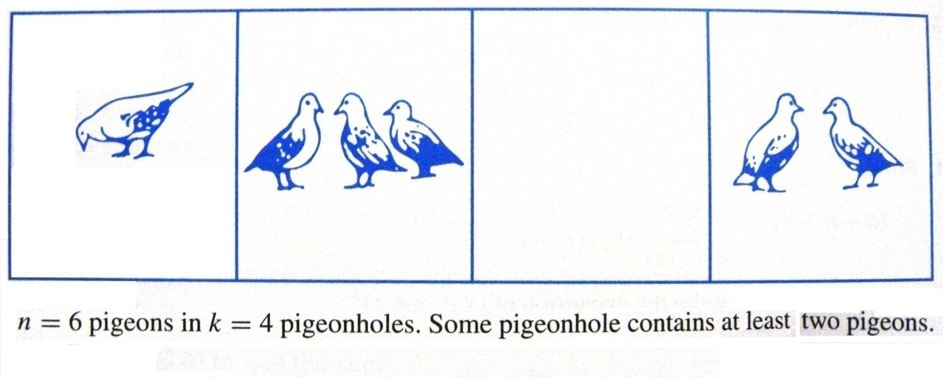
Pigeonhole Principle
The concept of Pigeons and Pigeonholes
Example
Challenge: Deciding which objects play the roles of (1) pigeons and (2) pigeonholes.

Slide 5
Pigeonhole Principle
First Form…
If n pigeons fly into k pigeonholes
and k < n
some pigeonhole contains at least two pigeons
E.g. Ten persons have first names Ann, Bev, Chi and last names Noah, Orr, Port.
Show that at least two persons have the same
first and last names.

Slide 6
Pigeonhole Principle
E.g. Ten persons have first names Ann, Bev, Chi and last names Noah, Orr, Port. Show that at least two persons have the same
first and last names.
There are nine possible names for the 10 persons. If we consider the persons as pigeons and the names as pigeonholes, by the Pigeonhole Principle
If n pigeons fly into k pigeonholes and k < n
some pigeonhole contains at least two pigeons
Therefore, some name is assigned to at least two persons.

Slide 7
Pigeonhole Principle
Second Form…
If f is a function from a finite set X to a finite set Y
and |X| > |Y|,
then f(x₁) = f(x₂) for some x₁, x₂ ϵ X, x₁ ≠ x₂
(Same as first form with X as pigeons and Y as the pigeonholes)
E.g. Show that if we select 151 distinct computer science books numbered 1 through to 300, at least two are consecutively numbered.

Slide 8
Pigeonhole Principle
E.g. Show that if we select 151 distinct computer science books numbered 1 through to 300, at least two are consecutively numbered.
Let the selected course numbers be
c₁, c₂, c₃, …, c₁₄₉, c₁₅₀, c₁₅₁
The 301 numbers including the selected courses are c₁+1, c₂+1, c₃+1, …, c₁₄₉+1, c₁₅₀+1
range from 1 to 300.
Considering set X to be 151 numbers of the books selected, and set Y to be numbers from 1 to 300 not consecutively numbered, i.e. max of 150. By the Pigeonhole Principle
a funct from a finite set X to a finite set Y and |X|>|Y|
then f(x₁) = f(x₂) for some x₁, x₂ ϵ X, x₁ ≠ x₂
and c_{i} = c_{j}+1 and at least two are consecutively numbered.

Slide 9
Pigeonhole Principle
Third Form…
Let f be a function from a finite set X into a finite set Y.
Suppose that |X| = n and |Y| = m.
┌ ┐
Let k = | n/m |
Then there are at least k values a₁, a₂ , … a_{k} ϵ X, such that
f(a₁) = f(a₂) = … = f(a_{k})
(Same as first form with X as pigeons and Y as the pigeonholes)

Slide 10
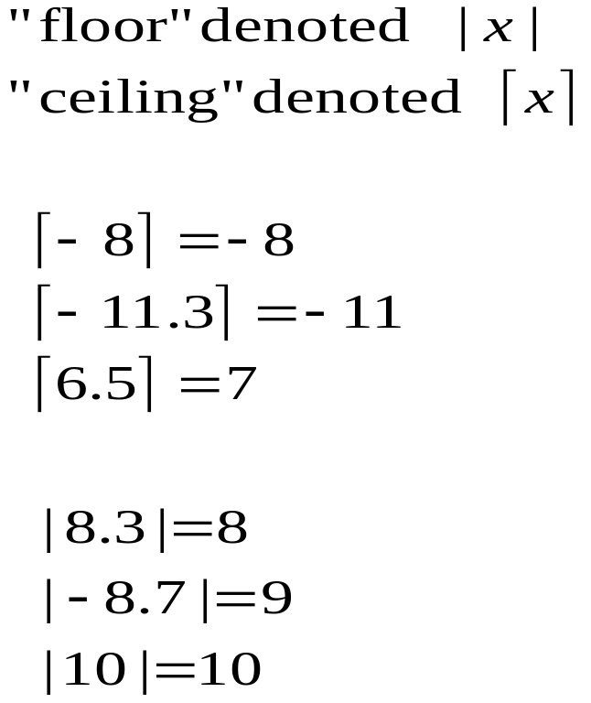
Recall floors and ceilings
  We define
  floor – the greatest integer less than or equal to the variable
  ceiling - the least integer greater than or equal to the variable

Slide 11
Pigeonhole Principle
Illustration - Third Form…
Assuming set X - {1, 2, 3, …, 12} and set Y - {a,b,...,e}
then |X| = n = 12 and |Y| = m = 5.
┌ ┐ ┌ ┐
Let k = | n/m | = | 2.4 | = 3
Then there are at least 3 values a₁, a₂, a₃ ϵ X, such that
f(a₁) = f(a₂) = f(a₃)
E.g. Each month in an MSc programme, exactly one course is offered. During 2010, five courses were offered. Show that at least one course lasted 3 months.

Slide 12
Pigeonhole Principle
E.g. Each month in an MSc programme, exactly one course is offered. During 2010, five courses were offered. Show that at least one course lasted 3 months.
Assuming X is the set of months - {1, 2, 3, …, 12} and Y is the set of courses - {c₁,c₂,c₃,c₄,c₅}
We have |X| = n = 12 and |Y| = m = 5.
┌ ┐ ┌ ┐
and k = | n/m | = | 2.4 | = 3
By the Pigeonhole Principle,
there are at least 3 months a₁, a₂, a₃ ϵ X,
such that f(a₁) = f(a₂) = f(a₃),
i.e. match the same course
Therefore at least one course lasted 3 months.

Slide 13
Fibonacci Numbers
The Fibonacci sequence {f_{n}}
is recursive and may be used for modeling recurrent relations
named in honour of Leonardo Fibonacci
found in unexpected places
appears in the analysis of algorithms, such as the Euclidean algorithm
may be used to prove many properties of the fibonacci numbers

Slide 14
Fibonacci Numbers
The Fibonacci sequence {f_{n}} is defined by the equations
f₁ = 1
f₂ = 1
f_{n} = f_{n-1} + f_{n-2} for all n ≥ 3
The Fibonacci sequence begins
1, 1, 2, 3, 5, 8, 13, …

Slide 15
Fibonacci Numbers
The Fibonacci sequence {f_{n}} is defined by the equations
f₀ = 0
f₁ = 1
f_{n} = f_{n-1} + f_{n-2} for all n ≥ 2
The Fibonacci sequence begins
0, 1, 1, 2, 3, 5, 8, 13, …

Slide 16
Fibonacci Numbers
The Fibonacci sequence is seen in unexpected places…
E.g. a pine cone with 13 clockwise spirals and 8 counterclockwise spirals.
Many plants distribute their seeds as evenly as possible, thus maximising the space available for each seed
The pattern in which the number of spirals is a Fibonacci number provides the most even distribution

Slide 17
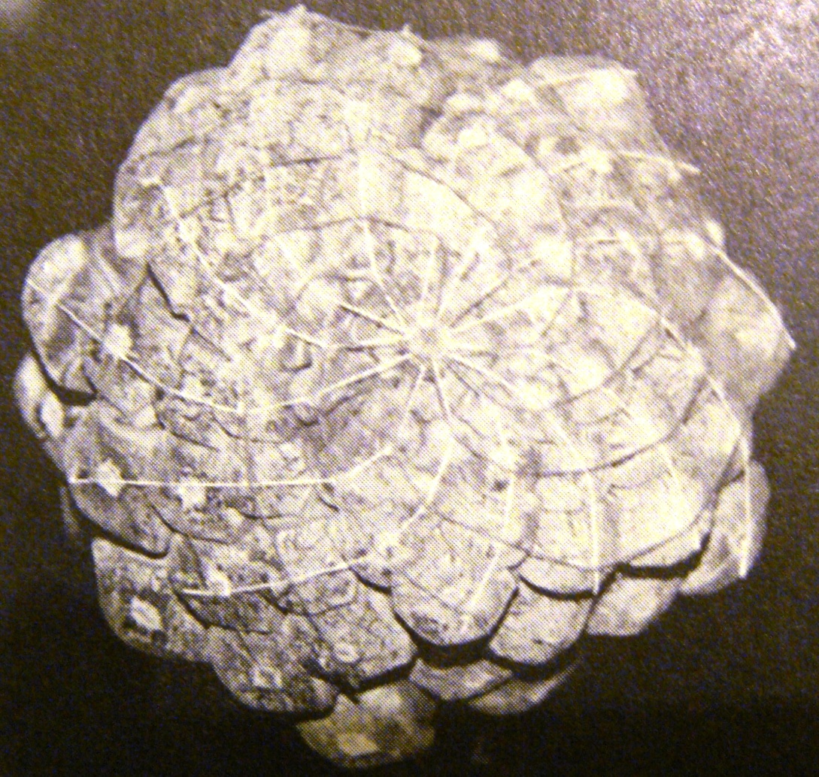
Fibonacci Numbers
The pine cone with 13 clockwise spirals (white threads) and 8 counterclockwise spirals (dark threads).

Slide 18
Fibonacci Numbers
Example
A young pair of rabbits (one of each sex) is placed on an island. A pair of rabbits does not breed until they are 2 months old. After they are 2 months old, each pair of rabbits produces another pair each month.
Find a recurrence relation for the number of pairs of rabbits on the island after n months, assuming no rabbits ever die.

Slide 19
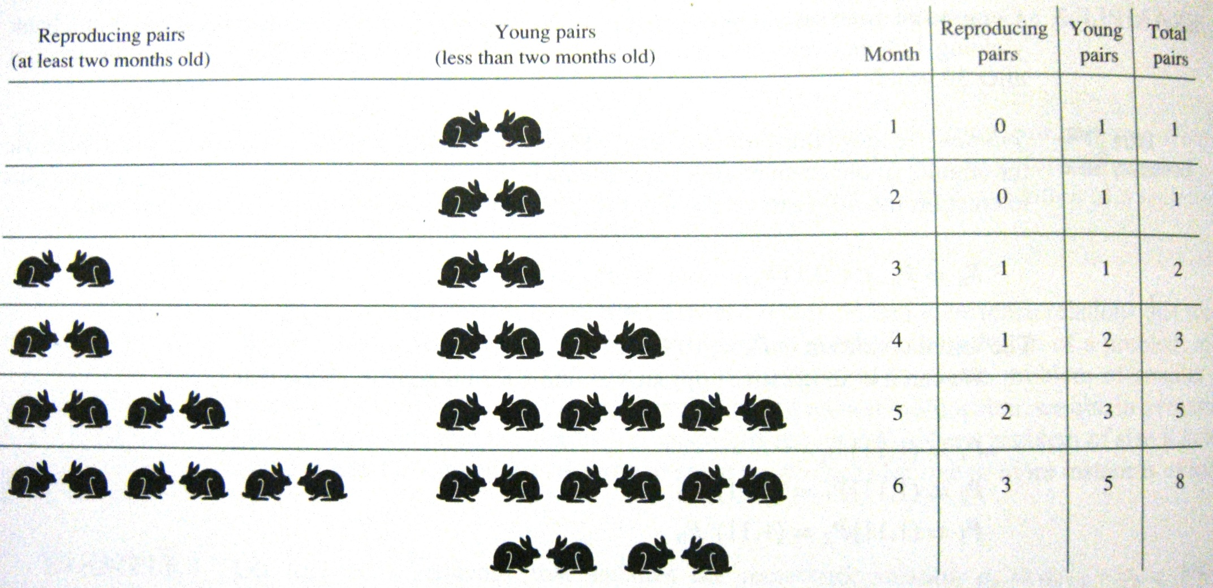
Fibonacci Numbers
A young pair of rabbits (one of each sex) is placed on an island. A pair of rabbits does not breed until they are 2 months old. After they are 2 months old, each pair of rabbits produces another pair each month.

Slide 20
Topics covered
Pigeonhole Principle
Fibonacci Numbers

